Slide 1



MultiThreading_Image_Processing
Use multithreading to process images
Presented by: Team 14

Slide 2



Project Overview
This project demonstrates the use of parallelization in Java to process PNG or JPG files by converting them from RGB format into three different output types:
Grayscale image
Histogram
Image with altered brightness

Slide 3


Why Multithreading?
Traditional image processing is sequential and slow
Modern CPUs have multiple cores → underutilized
Multithreading a lows:
Concurrent processing
Faster execution
Efficient resource use

Slide 4



Para lelization Modes
You can choose from three modes of para lelism:
Blocking
Splits the image into chunks and processes them (often using multiple threads).
Waits (blocks) until a l chunks are processed before assembling the final image.
If run on the UI thread, it may freeze the interface until completion.
Non-blocking
Executes processing asynchronously (using ca lbacks, futures, or an executor).
Keeps the UI responsive — ideal for real-time progress bars or interactive interfaces.
Once a l chunks are processed, the image is assembled and returned without
freezing the UI.
Single-threaded
Processes each pixel sequentia ly on a single thread (usua ly the ca ling thread).
The simplest method — no concurrency involved.
Slowest option for large images as it doesn't utilize multiple CPU cores.

Slide 5

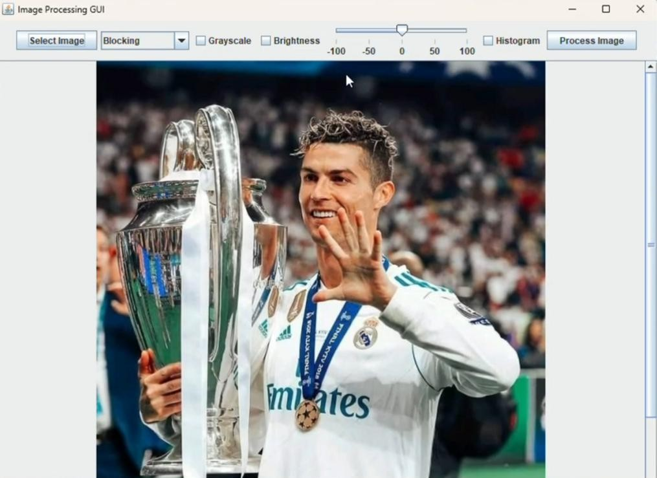
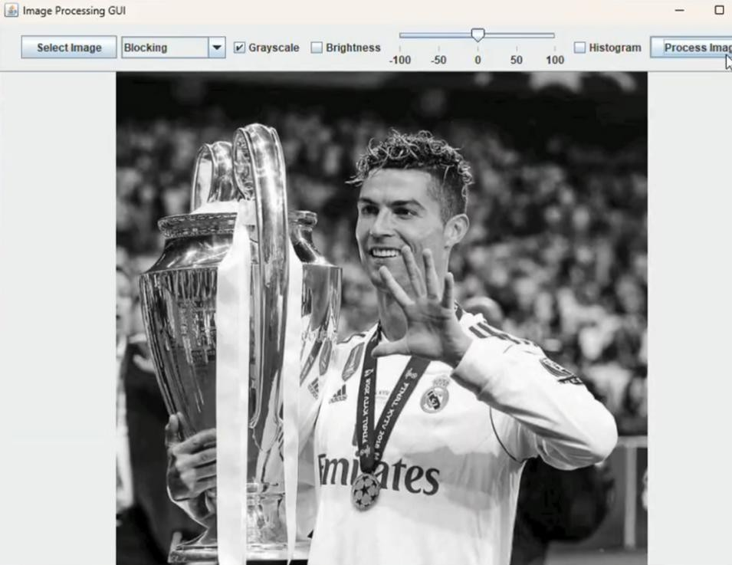
Grayscale image
1
2

Slide 6

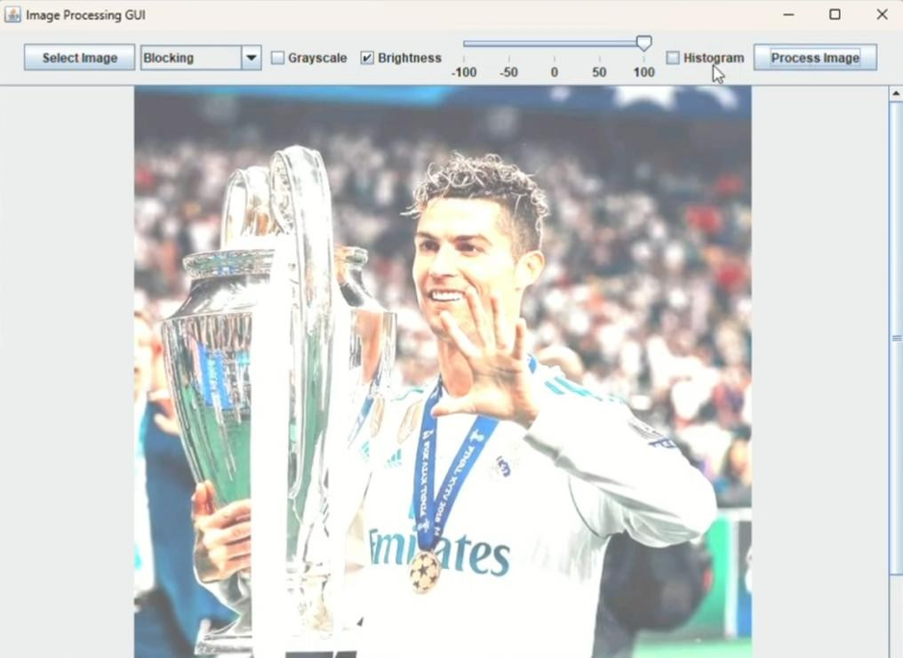
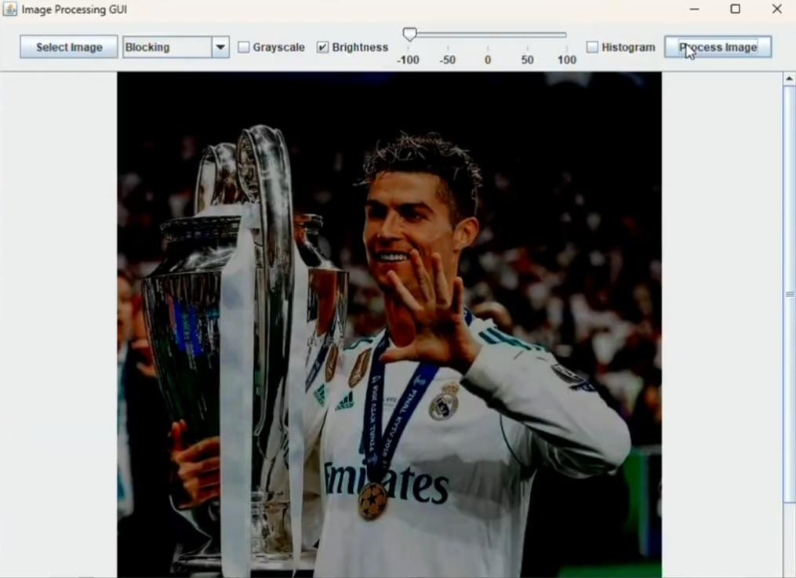
Image with altered brightness

Slide 7
Histogram
1

Slide 8
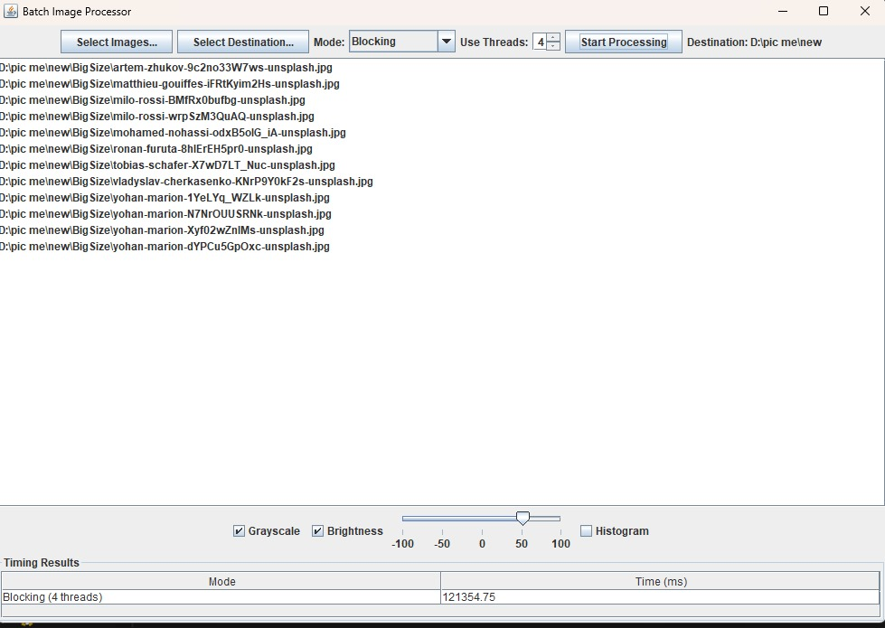
Blocking

Slide 9
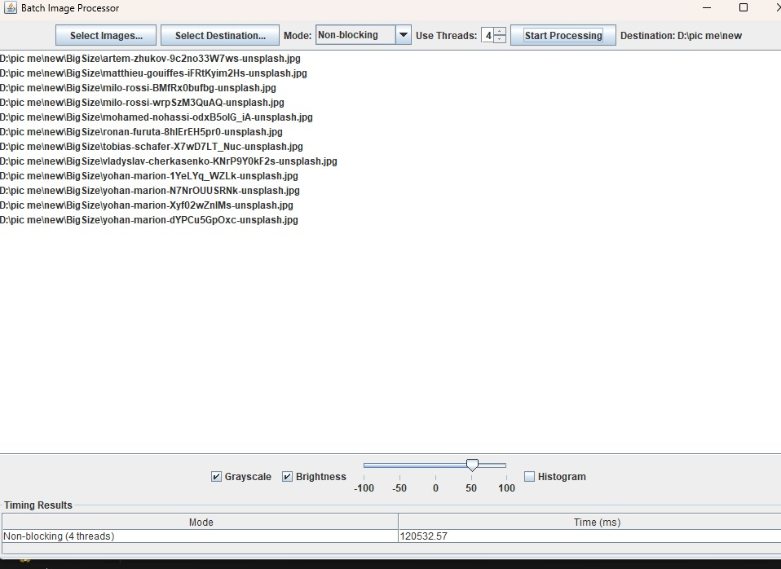
Non-blocking

Slide 10
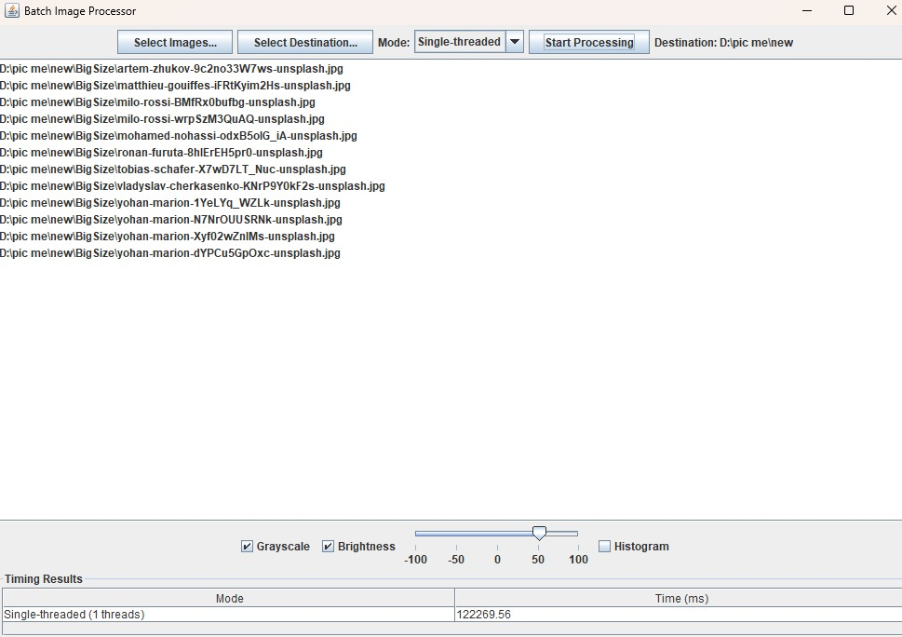
Single-Threaded

Slide 11



Thank You

